Slide 1

Chapter 8: Main Memory
Operating System Concepts – 8th Edition

Slide 2
Chapter 8: Memory Management
Background
Swapping
Contiguous Memory Allocation
Paging
Structure of the Page Table
Segmentation
Example: The Intel Pentium

Slide 3
Objectives
To provide a detailed description of various ways of organizing memory hardware
To discuss various memory-management techniques, including paging and segmentation
To provide a detailed description of the Intel Pentium, which supports both pure segmentation and segmentation with paging

Slide 4
Background
Program must be brought (from disk) into memory and placed within a process for it to be run
Main memory and registers are only storage CPU can access directly
Memory unit only sees a stream of addresses + read requests, or address + data and write requests
Register access in one CPU clock (or less)
Main memory can take many cycles
Cache sits between main memory and CPU registers
Protection of memory required to ensure correct operation

Slide 5
Why Memory management?
In an uniprogramming system, main memory is divided into two parts : one part for the operating system and the other part for the program currently being executed.
In multiprogramming system, the user part of memory is subdivided to accommodate multiple processes.
The task of subdivision is carried out dynamically by the operating system and is known as memory management.

Slide 6
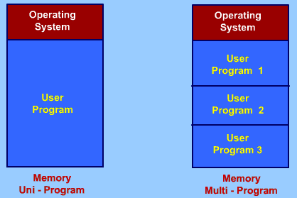
Why Memory management?

Slide 7
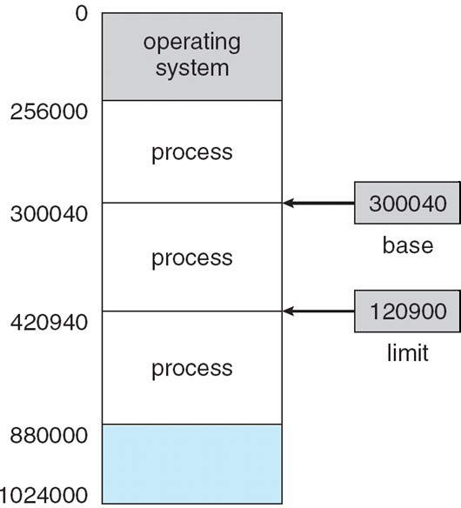
Base and Limit Registers
A pair of base and limit registers define the logical address space

Slide 8
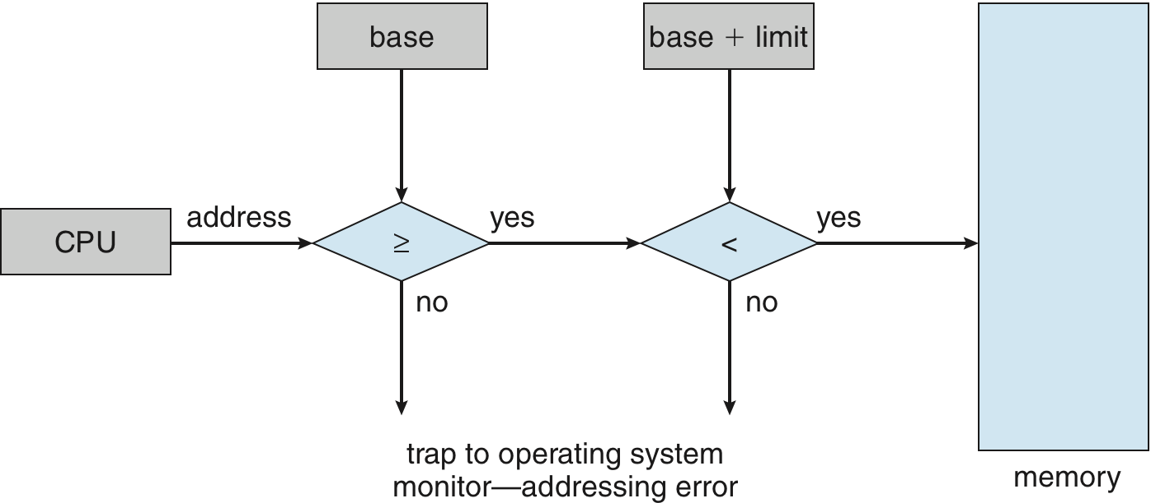
Hardware Address Protection with Base and Limit Registers

Slide 9
Logical vs. Physical Address Space
The concept of a logical address space that is bound to a separate physical address space is central to proper memory management
Logical address – generated by the CPU; also referred to as virtual address
Physical address – address seen by the memory unit
Logical and physical addresses are the same in compile-time and load-time address-binding schemes; logical (virtual) and physical addresses differ in execution-time address-binding scheme
Logical address space is the set of all logical addresses generated by a program
Physical address space is the set of all physical addresses generated by a program

Slide 10
Related term
Relocatable
Means that the program image can reside anywhere in physical memory.
Binding
Programs need real memory in which to reside. When is the location of that real memory determined?
This is called mapping logical to physical addresses.
This binding can be done at compile/link time. Converts symbolic to relocatable. Data used within compiled source is offset within object module.
Compiler:
If it’s known where the program will reside, then absolute code is generated. Otherwise compiler produces relocatable code.
Load:
Binds relocatable to physical. Can find best physical location.
Execution:
The code can be moved around during execution. Means flexible virtual mapping.

Slide 11
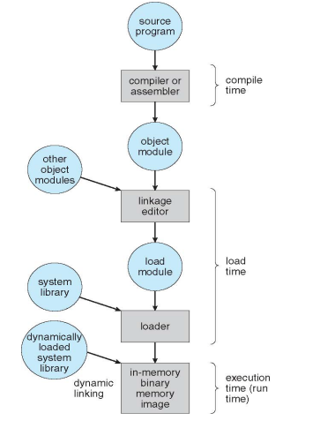

Multistep Processing of a User Program

Slide 12
Swapping
To utilize the idle time of CPU, we are shifting the paradigm from uniprogram environment to multiprogramming environment.
Since the size of main memory is fixed, it is possible to accommodate only few process in the main memory. If all are waiting for I/O operation, then again CPU remains idle.
To utilize the idle time of CPU, some of the process must be off loaded from the memory and new process must be brought to this memory place. This is known swapping.
Swapping is a mechanism in which a process can be swapped temporarily out of main memory to a backing store , and then brought back into memory for continued execution
The process waiting for some I/O to complete, must stored back in disk.
New ready process is swapped in to main memory as space becomes available.
As process completes, it is moved out of main memory.
If none of the processes in memory are ready,
Swapped out a block process to intermediate queue of blocked process.
Swapped in a ready process from the ready queue.

Slide 13
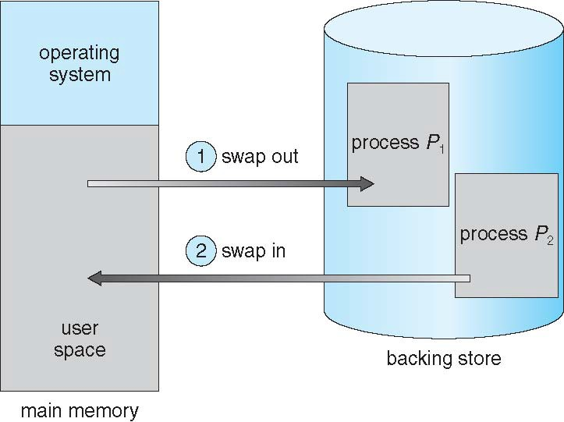
Schematic View of Swapping

Slide 14
Contiguous Allocation
Main memory usually into two partitions:
Resident operating system, usually held in low memory with interrupt vector
User processes then held in high memory
Each process contained in single contiguous section of memory
In. contiguous memory allocation, each process is contained in a single contiguous section of memory.

Slide 15
Contiguous Allocation (Cont.)
Problem arises in contiguous allocation
Hole – block of available memory; holes of various size are scattered throughout memory
When a process arrives, it is allocated memory from a hole large enough to accommodate it
Process exiting frees its partition, adjacent free partitions combined
Operating system maintains information about:
allocated partitions b) free partitions (hole)
OS
process 5
process 8
process 2
OS
process 5
process 2
OS
process 5
process 9
process 2
OS
process 5
process 9
process 10
process 2

Slide 16
Dynamic Storage-Allocation Problem
How to satisfy a request of size n from a list of free holes? or , how do you allocate memory to new processes?
First-fit: Allocate the first hole that is big enough
Best-fit: Allocate the smallest hole that is big enough; must search entire list, unless ordered by size
Produces the smallest leftover hole
Worst-fit: Allocate the largest hole; must also search entire list
Produces the largest leftover hole
First-fit and best-fit better than worst-fit in terms of speed and storage utilization

Slide 17
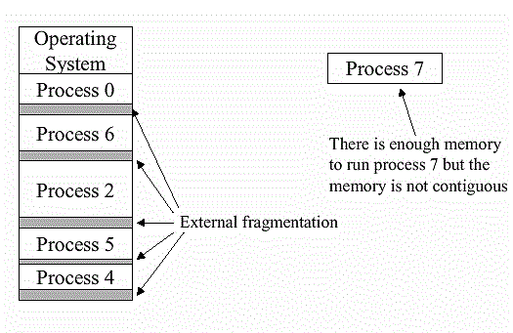
Fragmentation
External Fragmentation – total memory space exists to satisfy a request, but it is not contiguous
Internal Fragmentation – allocated memory may be slightly larger than requested memory; this size difference is memory internal to a partition, but not being used
First fit analysis reveals that given N blocks allocated, 0.5 N blocks lost to fragmentation
1/3 may be unusable -> 50-percent rule

Slide 18
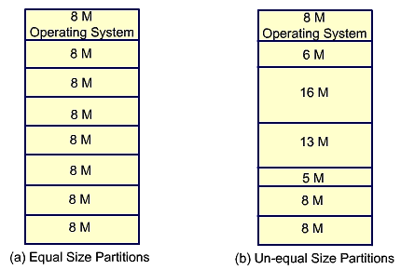
Fragmentation (Cont.)
Reduce external fragmentation by several ways:
Compaction: from time to time go through memory and move all free spaces into one free block of memory.
Partitioning: Splitting of memory into sections to allocate processes including operating system. There are two scheme for partitioning :
Fixed size partitions
Variable size partitions

Slide 19
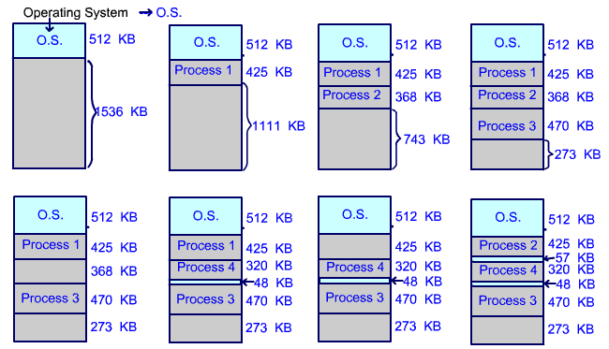
Effect of dynamic Portioning

Slide 20
Paging
Physical address space of a process can be noncontiguous; process is allocated physical memory whenever the latter is available
Paging is a technique in which physical memory is broken into blocks of the same size called pages (size is power of 2, between 512 bytes and 8192 bytes).
When a process is to be executed, its pages are loaded into any available memory frames from their source (a file system or the backing store).
The backing store is divided into fixed-sized blocks that are of the same size as the memory frames.
Keep track of all free frames
To run a program of size N pages, need to find N free frames and load program
Set up a page table to translate logical to physical addresses

Slide 21
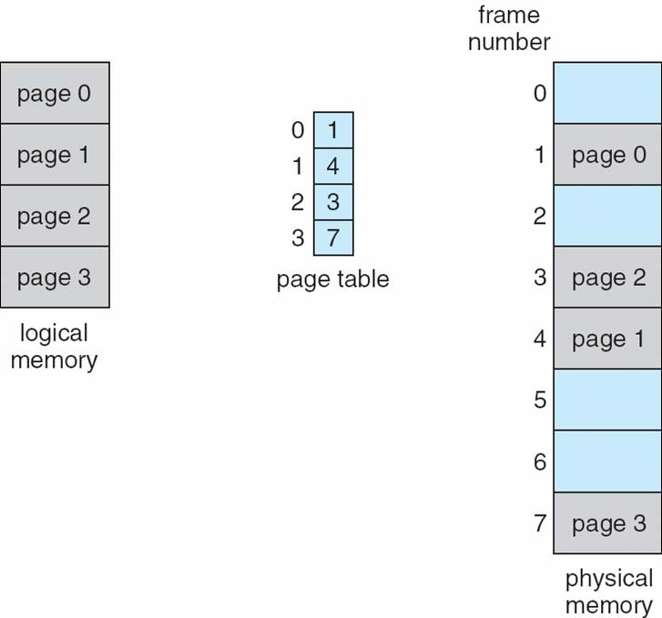
Paging Model of Logical and Physical Memory

Slide 22
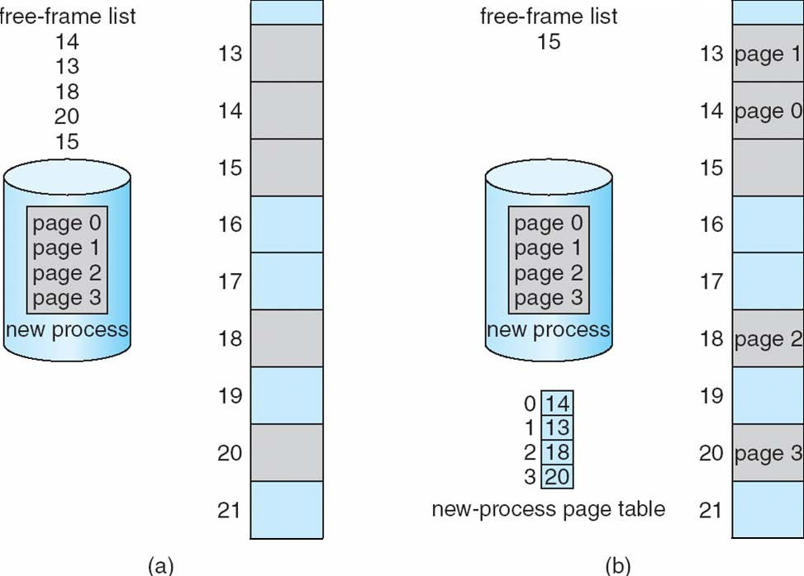
Paging: Free Frames
Before allocation
After allocation

Slide 23
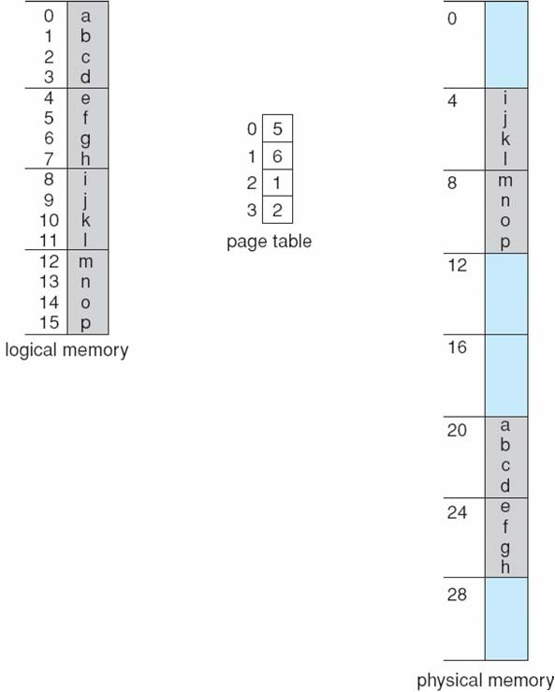
Paging Example : 32-byte memory with 4-byte pages
n=2 and m=4
32-byte memory and 4-byte pages

Slide 24
Implementation of Page Table
Page table is kept in main memory
Page-table base register (PTBR) points to the page table
Page-table length register (PTLR) indicates size of the page table
In this scheme every data/instruction access requires two memory accesses
One for the page table and one for the data / instruction
The two memory access problem can be solved by the use of a special fast-lookup hardware cache called
associative memory or translation look-aside buffers (TLBs)
Some TLBs store address-space identifiers (ASIDs) in each TLB entry – uniquely identifies each process to provide address-space protection for that process
Otherwise need to flush at every context switch
TLBs typically small (64 to 1,024 entries)
On a TLB miss, value is loaded into the TLB for faster access next time
Replacement policies must be considered
Some entries can be wired down for permanent fast access

Slide 25
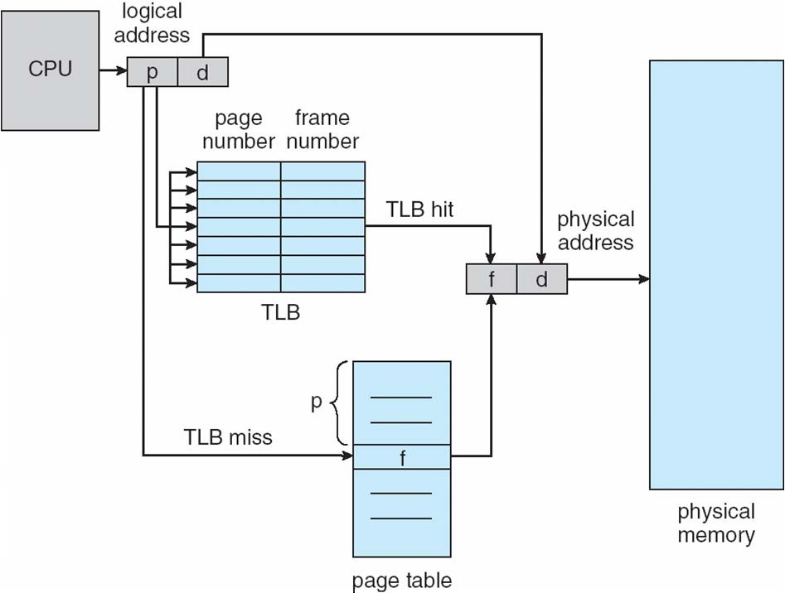
Paging Hardware With TLB

Slide 26
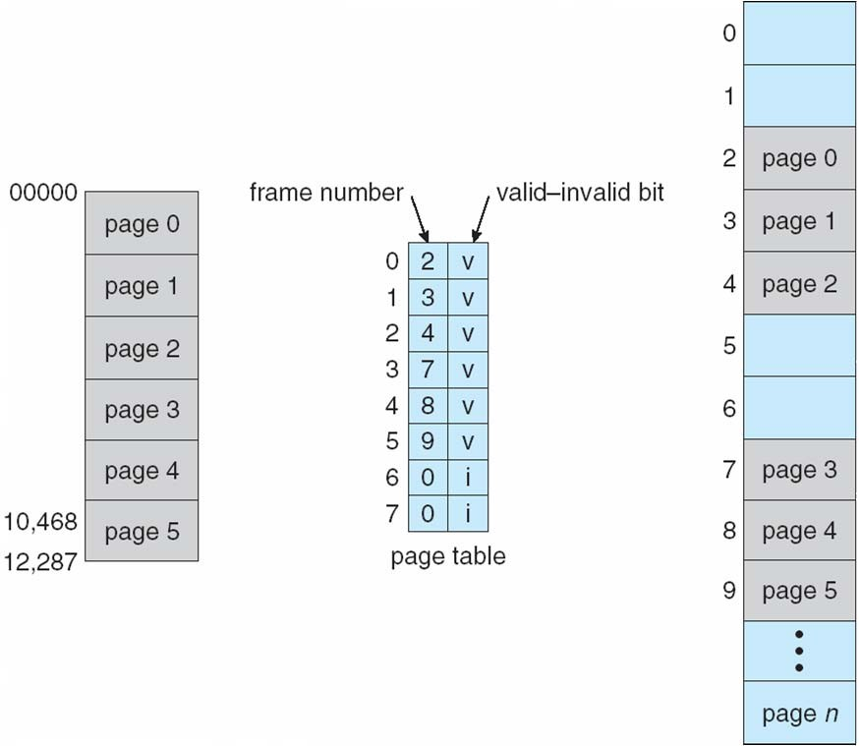
Valid (v) or Invalid (i)
Bit In A Page Table

Slide 27
Shared Pages
Shared code
One copy of read-only (reentrant) code shared among processes (i.e., text editors, compilers, window systems)
Similar to multiple threads sharing the same process space
Also useful for interprocess communication if sharing of read-write pages is allowed
Private code and data
Each process keeps a separate copy of the code and data
The pages for the private code and data can appear anywhere in the logical address space

Slide 28
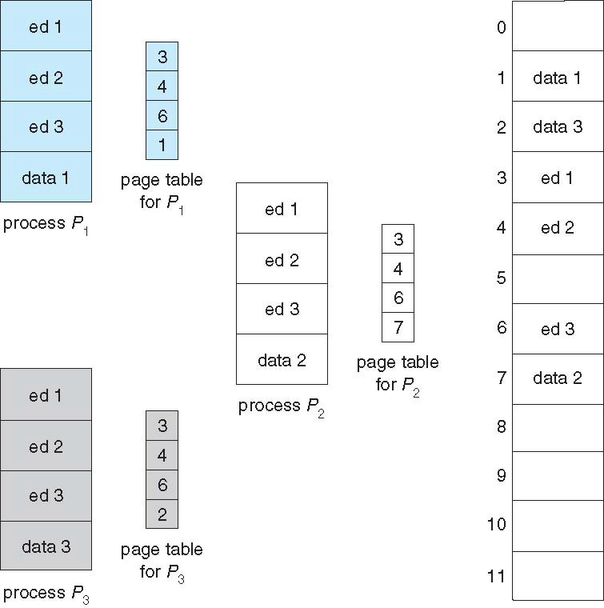
Shared Pages Example

Slide 29
Structure of the Page Table
Memory structures for paging can get huge using straight-forward methods
Consider a 32-bit logical address space as on modern computers
Page size of 4 KB (2¹²)
Page table would have 1 million entries (2³² / 2¹²⁾
If each entry is 4 bytes -> 4 MB of physical address space / memory for page table alone
 That amount of memory used to cost a lot
 Don’t want to allocate that contiguously in main memory
Hierarchical Paging
Hashed Page Tables
Inverted Page Tables

Slide 30
Hierarchical Page Tables
Break up the logical address space into multiple page tables
A simple technique is a two-level page table
We then page the page table

Slide 31
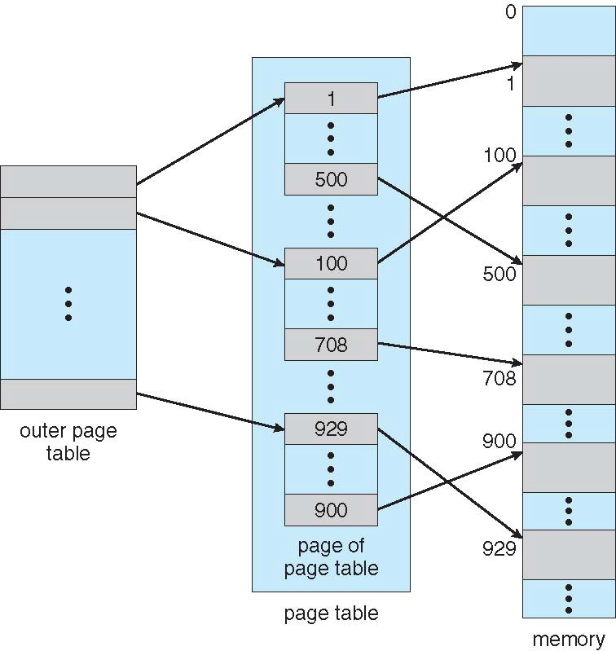
Two-Level Page-Table Scheme

Slide 32
Two-Level Paging Example
A logical address (on 32-bit machine with 1K page size) is divided into:
a page number consisting of 22 bits
a page offset consisting of 10 bits
Since the page table is paged, the page number is further divided into:
a 12-bit page number
a 10-bit page offset
Thus, a logical address is as follows:
page number |  | page offset
p₁ | p₂ | d
12
10 10
where p₁ is an index into the outer page table, and p₂ is the displacement within the
page of the inner page table
Known as forward-mapped page table

Slide 33
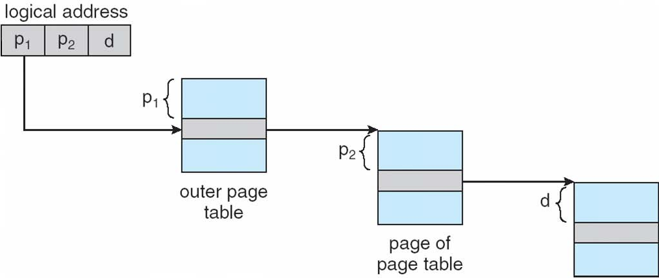
Address-Translation Scheme

Slide 34
64-bit Logical Address Space
Even two-level paging scheme not sufficient
If page size is 4 KB (2¹²)
Then page table has 2⁵² entries
If two level scheme, inner page tables could be 2¹⁰ 4-byte entries
Address would look like
outer page inner page |  | page offset
p₁ | p₂ | d
42
10 12
Outer page table has 2⁴² entries or 2⁴⁴ bytes
One solution is to add a 2nd outer page table
But in the following example the 2nd outer page table is still 2³⁴ bytes in size
 And possibly 4 memory access to get to one physical memory location

Slide 35
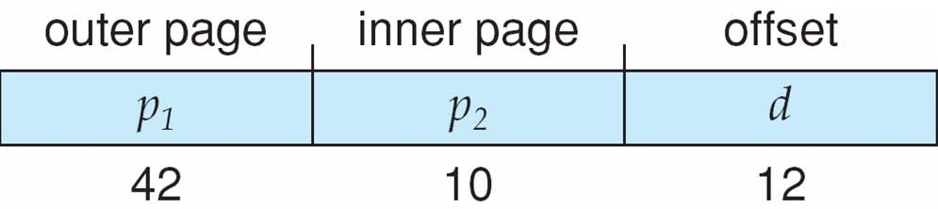
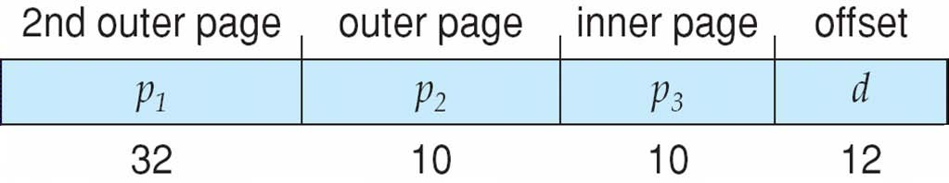
Three-level Paging Scheme

Slide 36
Hashed Page Tables
Common in address spaces > 32 bits
The virtual page number is hashed into a page table
This page table contains a chain of elements hashing to the same location
Each element contains (1) the virtual page number (2) the value of the mapped page frame (3) a pointer to the next element
Virtual page numbers are compared in this chain searching for a match
If a match is found, the corresponding physical frame is extracted

Slide 37
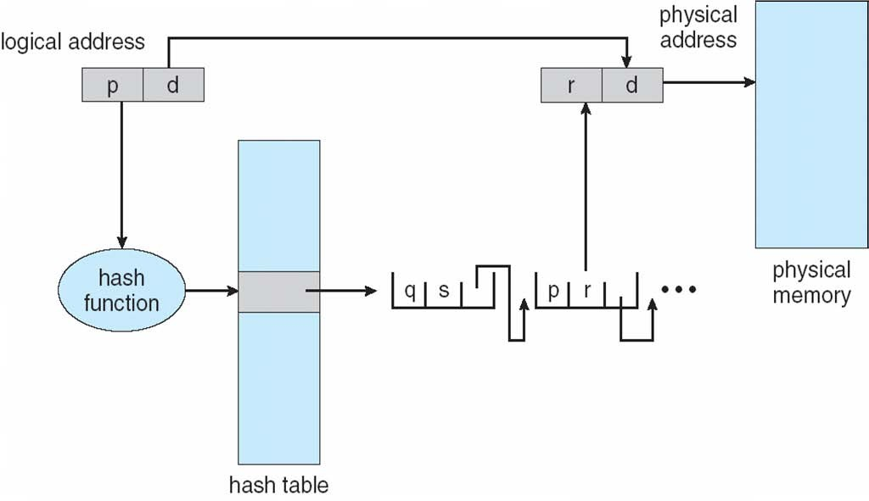
Hashed Page Table

Slide 38
Inverted Page Table
Rather than each process having a page table and keeping track of all possible logical pages, track all physical pages
One entry for each real page of memory
Entry consists of the virtual address of the page stored in that real memory location, with information about the process that owns that page
Decreases memory needed to store each page table, but increases time needed to search the table when a page reference occurs
Use hash table to limit the search to one — or at most a few — page-table entries
TLB can accelerate access
But how to implement shared memory?
One mapping of a virtual address to the shared physical address

Slide 39
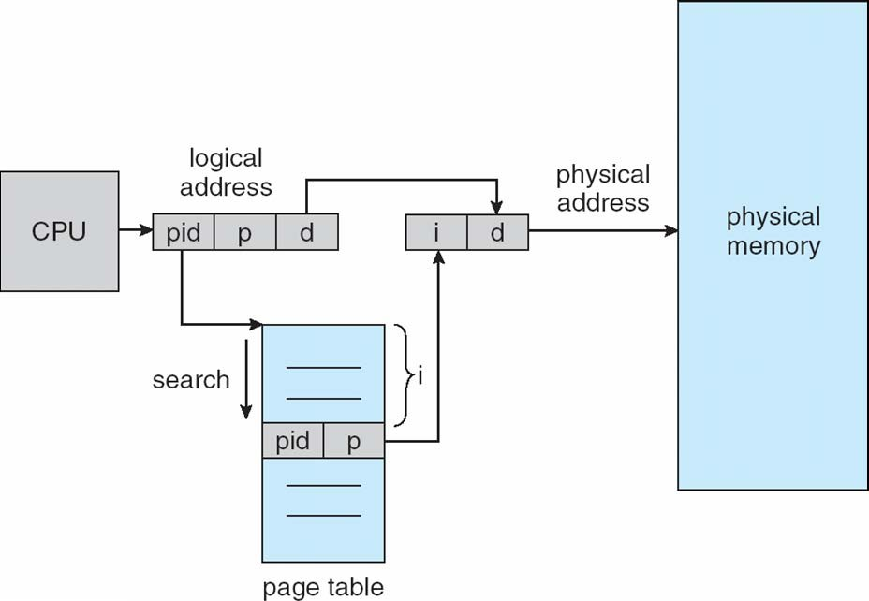
Inverted Page Table Architecture

Slide 40
Segmentation
Memory-management scheme that supports user view of memory
Program needs to treat different pieces of its memory differently. Examples:
process should be able to execute its code, but not its data.
process should be able to write its data, but not its code. Process should share part of memory with other processes, but not all of memory.
some memory may need to be exported read-only, other memory exported read/write.
Mechanism to support treating different pieces of address space separately: segments.
Thus, segmentation is a technique to break memory into logical pieces where each piece represents a group of related information.

Slide 41
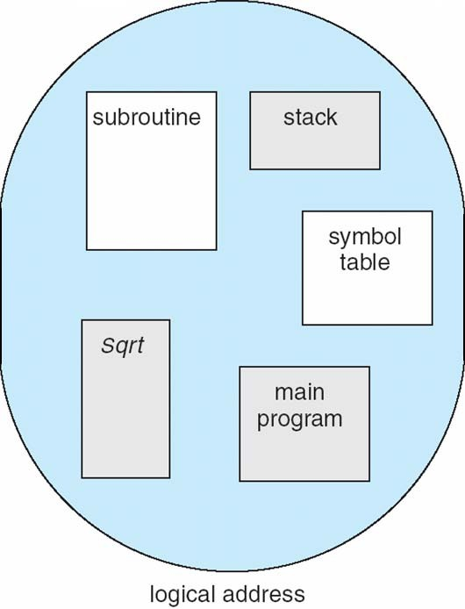
User’s View of a Program
A program is a collection of segments
A segment is a logical unit such as: main program procedure function method object, local variables, global variables common block, stack symbol table arrays

Slide 42
Logical View of Segmentation
1
1
4
2
3
4
2
3
user space
physical memory space

Slide 43
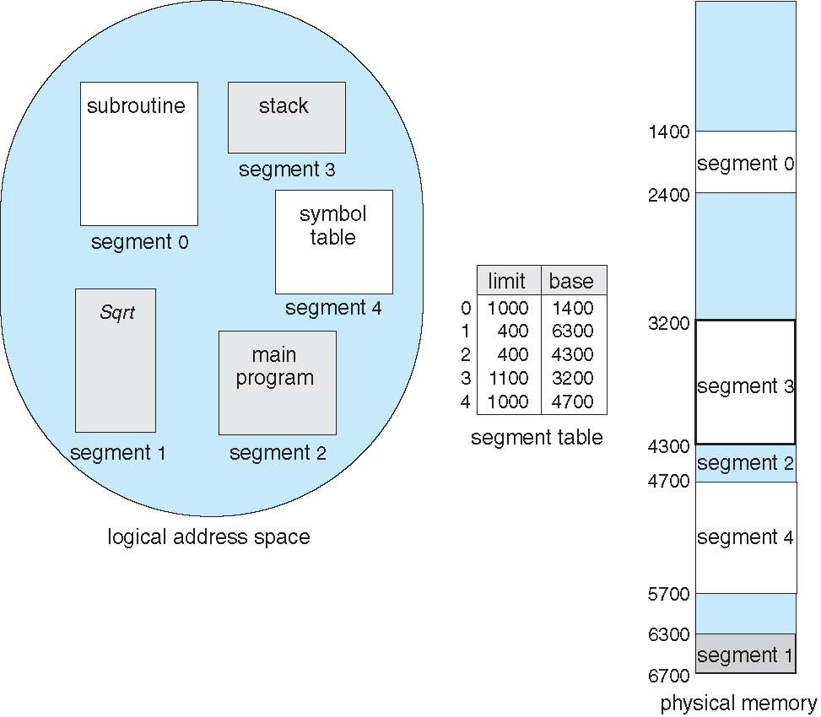
Example of Segmentation

Slide 44
Example: The Intel Pentium
Supports both segmentation and segmentation with paging
Each segment can be 4 GB
Up to 16 K segments per process
Divided into two partitions
 First partition of up to 8 K segments are private to process (kept in local descriptor table LDT)
 Second partition of up to 8K segments shared among all processes (kept in global descriptor table GDT)
CPU generates logical address
Given to segmentation unit
 Which produces linear addresses
Linear address given to paging unit
 Which generates physical address in main memory
 Paging units form equivalent of MMU
 Pages sizes can be 4 KB or 4 MB

Slide 45
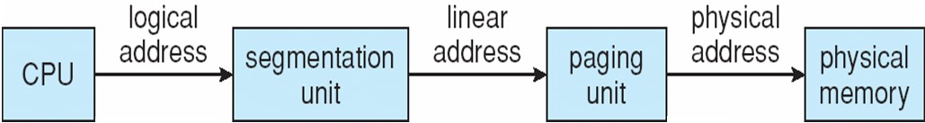
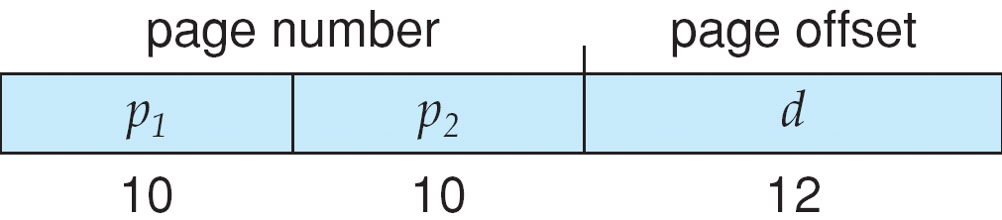
Logical to Physical Address
Translation in Pentium

Slide 46
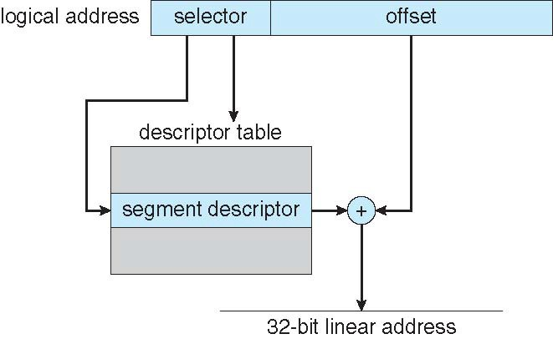
Intel Pentium Segmentation

Slide 47
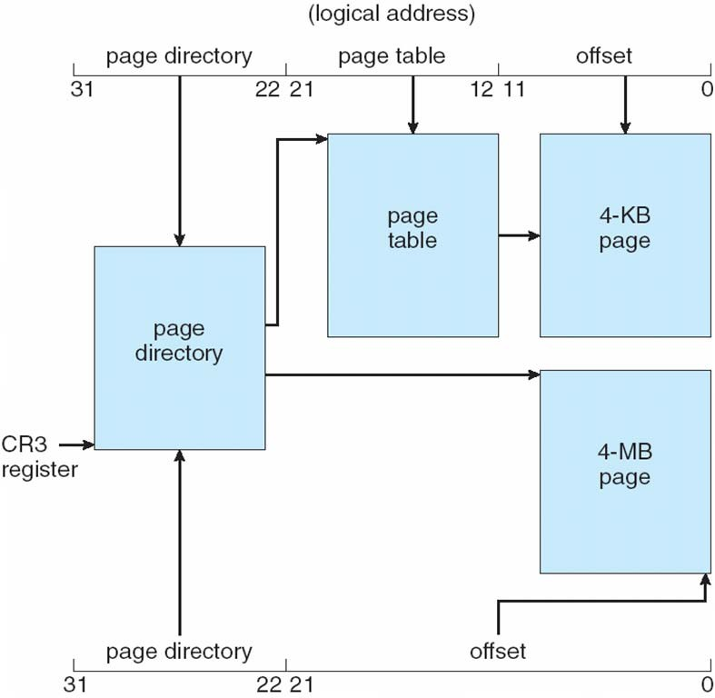
Pentium Paging Architecture

Slide 48
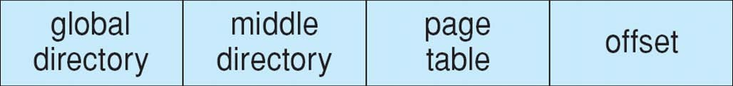
Linear Address in Linux
Linux uses only 6 segments (kernel code, kernel data, user code, user data, task-state segment (TSS), default LDT segment)
Linux only uses two of four possible modes – kernel and user
Uses a three-level paging strategy that works well for 32-bit and 64-bit systems
Linear address broken into four parts:
But the Pentium only supports 2-level paging?!

Slide 49
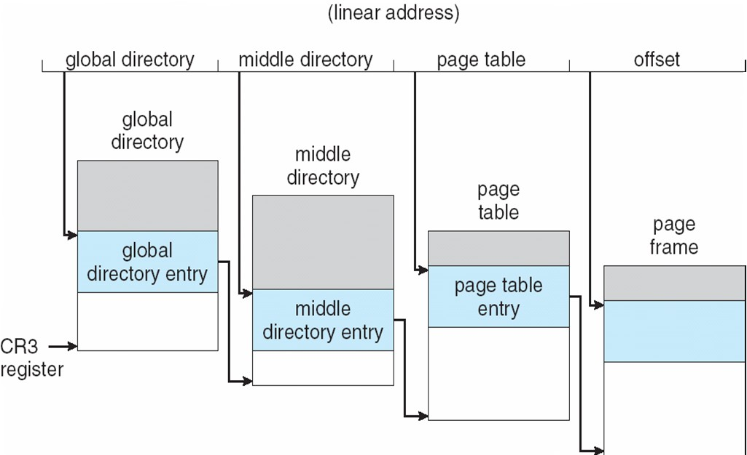
Three-level Paging in Linux

Slide 50
End of Chapter 8
Operating System Concepts – 8th Edition

